Slide 1
CompliChain
Digitalization of Climate & Environment risk management
Solution for Compliance in the Financial Sector with Tezos
Notes:
By … increasing gren energy production on Public infra assets
By … enabling carbon free kwh sharing between Public admins
By … optimizing new production capabilities covering needs
We can do much more that 15-20%, and this more can even be greener !

Slide 2
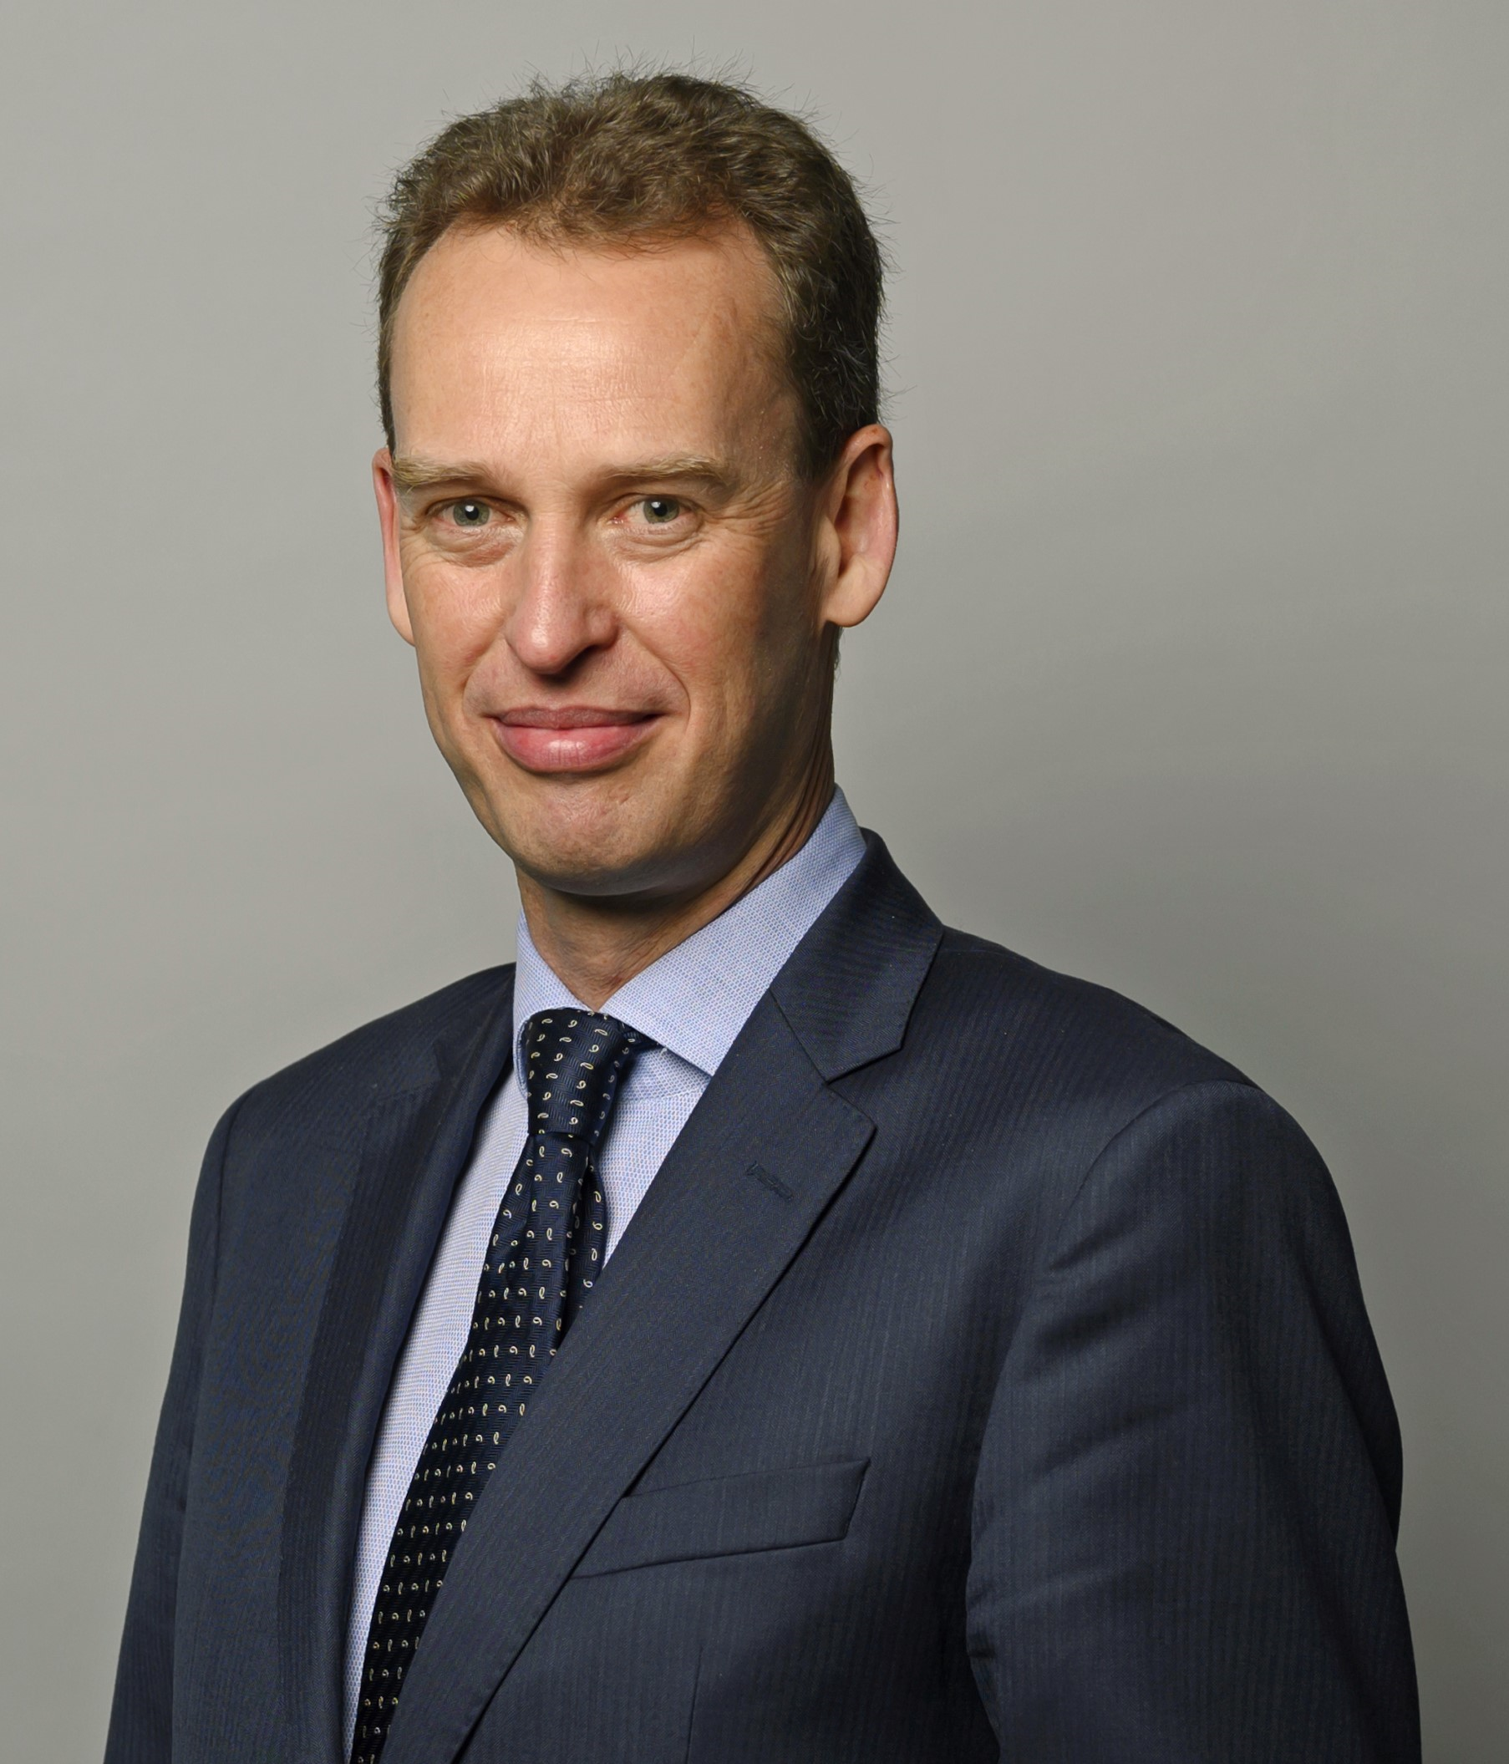
“Climate and environmental risks, a major risk for our society but a real management challenge for financial institutions “
Frank Elderson – Executive Board Member of European Central Bank (ECB)
16.11.2023 Sustainable Finance Conference (QED)
Notes:
By … increasing gren energy production on Public infra assets
By … enabling carbon free kwh sharing between Public admins
By … optimizing new production capabilities covering needs
We can do much more that 15-20%, and this more can even be greener !

Slide 3

Data and risk evaluation are mainly maintained into spreadsheets
Notes:
By … increasing gren energy production on Public infra assets
By … enabling carbon free kwh sharing between Public admins
By … optimizing new production capabilities covering needs
We can do much more that 15-20%, and this more can even be greener !

Slide 4

Risk evaluation is commonly processed manually
Notes:
By … increasing gren energy production on Public infra assets
By … enabling carbon free kwh sharing between Public admins
By … optimizing new production capabilities covering needs
We can do much more that 15-20%, and this more can even be greener !

Slide 5

Competencies and resources are rare and limited
Notes:
By … increasing gren energy production on Public infra assets
By … enabling carbon free kwh sharing between Public admins
By … optimizing new production capabilities covering needs
We can do much more that 15-20%, and this more can even be greener !

Slide 6

Quantification methods and models are complex, data are not easy to obtain
Notes:
By … increasing gren energy production on Public infra assets
By … enabling carbon free kwh sharing between Public admins
By … optimizing new production capabilities covering needs
We can do much more that 15-20%, and this more can even be greener !

Slide 7










Risk Mgt Front-end Application
Meet increasingly granular regulatory requirements in terms of climate-related and environmental risks
Financial institution
Private Data
Smart Contract
Financial institution with an investment activity
NFT
CSSF
Public Data
InterPlanetary
File System (IPFS)
Investors
Risk evaluation is initiated
Data & documents are collected
Calculation is processed in blockchain
Certification is issued & audit trail available
Funds stakeholders are informed about risk

Slide 8
Blockchain is a facilitator and an accelerator to digitize
climate and environmental risk management
Smart Contracts are used to build audit trail of data source, processing, and calculations
NFT’s are valuable to support certification and authenticity
Decentralized ledgers are enabling easier population of information
Notes:
By … increasing gren energy production on Public infra assets
By … enabling carbon free kwh sharing between Public admins
By … optimizing new production capabilities covering needs
We can do much more that 15-20%, and this more can even be greener !

Slide 9
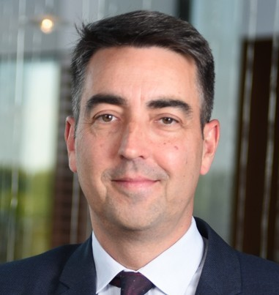

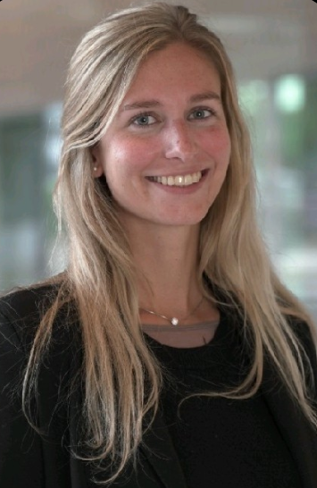
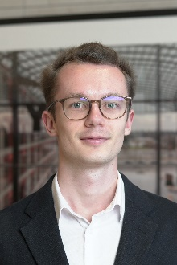
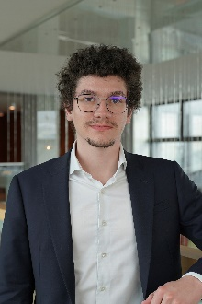
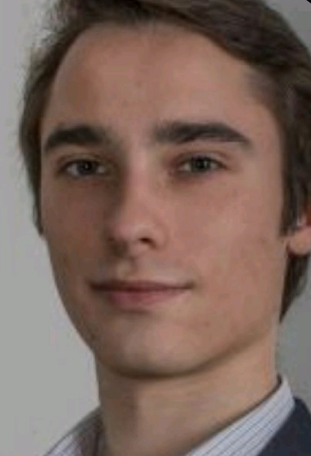
EY TEAM
Blockchain Hackathon
Infrachain
Challenge
2023
“Tezos Blockchain to facilitate compliance in Luxembourg’s financial sector”
November 28th and 29th
^{Telindus, Luxembourg}
Pierre-Jean FORRER
Technology Consulting Partner & Team Captain
Marie-Charlotte PAINDAVOINE
Senior Consultant, Functional analyst
Alexia BUTAYE
Senior Consultant, Business Expert
Jules BOYER
Consultant, Blockchain coder
Julien GIET
Consultant, Front-end coder
Baptiste DURAND
Consultant, Front-end coder

Slide 10

EY CompliChain Solution
Page Web / dApp
Smart Contract 2:
Gérer les NFTs
Owner: Smart Contract 1
Stockage: Toutes les NFTs
Transactions:
Création NFT
Suppression NFT
Remplacement / Update NFT
6. Association NFT au wallet
NFT
Emetteur
Fond
Actifs
Score
Timestamp
1:N
Wallet User X
4. Appel de la transaction
9. Update
NFT CSSF
Emetteur
Fond
Actifs
Score
Timestamp
3. Préparation de la transaction
Prospectus
5. Demande de création de NFT
Send
8. Demande d’update / Suppression
Smart Contract 1:
Gérer les données
Owner: CSSF Wallet
Stockage: Lien des documents et données
Transactions:
Stockage des liens
Calcul
Génération de la NFT associée
Validation du report
1:N
1. Stocker:
- les documents
- les données
Wallet CSSF
IPFS
Documents
Données pour calcul
2. Renvoyer le hash vers les documents / données
7. Appel de la transaction (via dApp)

